Slide 1
Audio Training
2016-1-29
Andy Zheng

Slide 2
Agenda
Audio basic knowledge sharing
Audio codecs
Room processing
RPD/RPM audio
Introduce our internal audio debug tool

Slide 3
Agenda
Audio basic knowledge sharing
Audio codecs
Room processing
RPD/RPM audio
Introduce our internal audio debug tool

Slide 4
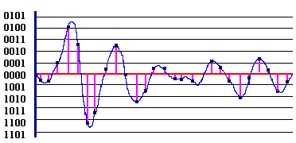
Audio basic knowledge sharing
语音信号的数字化
通过电脑或者其它数字录音设备采集的语音信号都已经经过数字化了，
一般不需要用户再进行数字化处理。尽管如此，有必要简单了解一下语音信
号的数字化过程与原理。
模拟语音信号在时间与幅度上的二重连续性
时间上离散化：每秒钟需要采集多少个声音样本，也就是采样
频率(f_{s})是多少。
幅值上离散化：每个声音样本的位数(bit per sample，bps)
应该是多少，也就是量化精度。

Slide 5
Audio basic knowledge sharing
语音信号的采样频率
奈奎斯特采样定理：f_{s}> 2 f_{max}
窄带语音信号： f_{s} =8000Hz
电话语音（固网电话通信频带为300-3400Hz)
可以基本保持语义，不影响人对语音的感知
质量不是很好，有时候会有变音
宽带语音信号：f_{s} =16000Hz
一般对语音质量要求较高的场合
再提高采样频率也不会对语音质量有太多贡献

Slide 6
Audio basic knowledge sharing
量化精度
量化所用比特越大，声音质量越好
声音质量也跟量化算法有关，比如同样用8bit量化，非均匀量化（µ-律或A-律）就比均匀量化好很多
固网电话语音量化就是用的非均匀量化
声音的质量与数据率（采样频率和量化精度）的关系
质量 | 采样频率 (kHz) | 样本精度 (bit/s) | 单道声/ 立体声 | 数据率(kB/s) (未压缩) | 频率范围
电话 | 8 | 8 | 单道声 | 8 | 300～3400 Hz
AM | 11.025 | 8 | 单道声 | 11.0 | 20～5000 Hz
FM | 22.050 | 16 | 立体声 | 88.2 | 50～7000 Hz
CD | 44.1 | 16 | 立体声 | 176.4 | 20～20000 Hz
DAT | 48 | 16 | 立体声 | 192.0 | 20～20000 Hz

Slide 7
Agenda
Audio basic knowledge sharing
Audio codecs
Room processing
RPD/RPM audio
Introduce our internal audio debug tool

Slide 8
ITU-T Audio Codecs
Basic parameters
Audio bandwidth & Sample Rate & Bitrate
ITU-T Audio Codecs
G.711 (8KHz) - popular
G.722 (16KHz)
G.729A (8KHz)
G.722.1 ~ G.719
G722.1 (16KHz)
G722.1.C (32KHz)
G.719 (48KHz)
Others
iLBC(voip) SILK(skype codec) Speex
Opus(WebRTC default codec)

Slide 9
Polycom Audio Codecs
Siren 7
Replace G.728, for audio quality and performance
Siren14
Siren 14 / G722.1.C
Siren 14 mono (24k/32k/48k) /stereo
Siren22
Siren22mono(32k/48k/64k)
Siren22stereo(64k/96k/128k)
SirenLpr
Siren22Lprmono(32k/48k/64k)
Siren22Lprstereo(64k/96k/128k)
SACLpr
SACLprmono(48k)

Slide 10
SirenLPR
Developed by Peter Chu
A hybrid version of Siren14 and Siren22.
Sampling rate: 48kHz
Bandwidth: 22kHz
Full packet recovery up to 80% (8 lost packets then followed by 2 good packets)

Slide 11
What is SAC?
An audio codec is scalable if the decoder generates a better audio signal as more bits are appended to the bit stream.
From a different point of view, the decoder of a scalable codec is able to generate the useful audio signal, even if bits are stripped off the bit stream (i.e., the partial bit stream) at the reduced audio quality.

Slide 12
Core idea of Siren SAC: bit re-ordering
Bit packed first
Bit packed last
(a)
1
0
0
1
1
……………………
1
1
0
1
0
Region 0
Region 1
Region N
Bit packed first
ddmost
Bit packed last
(b)
1
0
0
1
1
……………………
1
1
0
1
0
Most Important
Region
2nd Most Important
Region
Least Important
Region
Bit packed first
Bits are stripped
Bit packed last
(c)
1
0
ddmost
0
1
1
……………………
1
1
0
1
0
Most Important
Region
2nd Most Important
Region
Least Important
Region

Slide 13
SAC used in MRM
MRC uses a scalable version of Siren 22
The VAD (Voice Activity Detection bit) and energy are carried in the RTP header.
Utilizes a media-wise LPR mechanism.
Audio Scalability:
10K
10K
10K
48K
48K
Uplink (MRE to MRM)
Downlink (MRM to MRE)

Slide 14
Audio Codec Priority
Call Rate | Stereo Preference Order | Mono Preference Order
>=1024
 | G.719 Stereo 256* | G.719 128
 | G.719 Stereo 192* | G.719 96
 | G.719 Stereo 128 | G.719 64
 | Siren22 Stereo 128 | SAC-LPR 64
 | SAC-LPR Stereo 128 | Siren22 64
 | SAC-LPR Stereo 96 | G.719 64
 | Siren22 Stereo 96 | SAC-LPR 48
 | G.719 Stereo 96 | Siren22 48
 | Siren14 Stereo 96 | G.719 48
 | SAC-LPR Stereo 64 | G.722.1 Annex C 48
 | Siren22 Stereo 64 | Siren14 48
 | G.719 Stereo 64 | SAC-LPR 32
 | Siren14 Stereo 64 | Siren22 32
 | SAC-LPR Stereo 48 | G.719 32
 | Siren14 Stereo 48 | G.722.1 Annex C 32
 |  | Siren14 32
 |  | G.722
 |  | G.722.1 32
 |  | SAC-LPR 24
 |  | G.722.1 24
 |  | G.722.1 16
 |  | G.711µ
 |  | G.711A
 |  | G.728
 |  | G.729A
>= 768
 | G.719 Stereo 256* | G.719 128
 | G.719 Stereo 192* | G.719 96
 | G.719 Stereo 128 | G.719 64
 | Siren22 Stereo 128 | SAC-LPR 64
 | SAC-LPR Stereo 128 | Siren22 64
 | SAC-LPR Stereo 96 | G.719 64
 | Siren22 Stereo 96 | SAC-LPR 48
 | G.719 Stereo 96 | Siren22 48
 | Siren14 Stereo 96 | G.719 48
 | SAC-LPR Stereo 64 | G.722.1 Annex C 48
 | Siren22 Stereo 64 | Siren14 48
 | G.719 Stereo 64 | SAC-LPR 32
 | Siren14 Stereo 64 | Siren22 32
 | SAC-LPR Stereo 48 | G.719 32
 | Siren14 Stereo 48 | G.722.1 Annex C 32
 |  | Siren14 32
 |  | G.722
 |  | G.722.1 32
 |  | SAC-LPR 24
 |  | G.722.1 24
 |  | G.722.1 16
 |  | G.711µ
 |  | G.711A
 |  | G.728
 |  | G.729A
Notes:
在不同的呼叫速率下，如何选择audio codec。

Slide 15
Audio Codec Priority
>= 512
 | G.719 Stereo 192* | G.719 128
 | G.719 Stereo 128 | G.719 96
 | Siren22 Stereo 128 | G.719 64
 | SAC-LPR Stereo 128 | SAC-LPR 64
 | SAC-LPR Stereo 96 | Siren22 64
 | Siren22 Stereo 96 | G.719 64
 | G.719 Stereo 96 | SAC-LPR 48
 | Siren14 Stereo 96 | Siren22 48
 | SAC-LPR Stereo 64 | G.719 48
 | Siren22 Stereo 64 | G.722.1 Annex C 48
 | G.719 Stereo 64 | Siren14 48
 | Siren14 Stereo 64 | SAC-LPR 32
 | SAC-LPR Stereo 48 | Siren22 32
 | Siren14 Stereo 48 | G.719 32
 |  | G.722.1 Annex C 32
 |  | Siren14 32
 |  | G.722
 |  | G.722.1 32
 |  | SAC-LPR 24
 |  | G.722.1 24
 |  | G.722.1 16
 |  | G.711µ
 |  | G.711A
 |  | G.728
 |  | G.729A
>= 384
 | G.719 Stereo 128 | G.719 128
 | Siren22 Stereo 128 | G.719 96
 | SAC-LPR Stereo 96 | G.719 64
 | Siren22 Stereo 96 | SAC-LPR 64
 | G.719 Stereo 96 | Siren22 64
 | Siren14 Stereo 96 | G.719 64
 | SAC-LPR Stereo 64 | SAC-LPR 48
 | Siren22 Stereo 64 | Siren22 48
 | G.719 Stereo 64 | G.719 48
 | Siren14 Stereo 64 | G.722.1 Annex C 48
 | SAC-LPR Stereo 48 | Siren14 48
 | Siren14 Stereo 48 | SAC-LPR 32
 |  | Siren22 32
 |  | G.719 32
 |  | G.722.1 Annex C 32
 |  | Siren14 32
 |  | G.722
 |  | G.722.1 32
 |  | G.722.1 24
 |  | G.722.1 16
 |  | G.728
 |  | G.711µ
 |  | G.711A
 |  | G.729A
Notes:
在不同的呼叫速率下，如何选择audio codec。

Slide 16
Audio Codec Priority
>= 256
 | None | SAC-LPR 32
 |  | Siren22 32
 |  | G.719 32
 |  | G.722.1 Annex C 32
 |  | Siren14 32
 |  | G.722
 |  | G.722.1 32
 |  | SAC-LPR 24
 |  | G.722.1 24
 |  | G.722.1 16
 |  | G.728
 |  | G.711µ
 |  | G.711A
 |  | G.729A
> 96
 | None | SAC-LPR 24
 |  | G.722.1 Annex C 24
 |  | Siren14 24
 |  | G.722.1 24
 |  | G.722.1 16
 |  | G.728
 |  | G.729A
 |  | G.722
 |  | G.711µ
 |  | G.711A
<= 96
 | None | G.722.1 16
 |  | G.729A
 |  | G.728
 |  | G.722
 |  | G.711µ
 |  | G.711A
Notes:
在不同的呼叫速率下，如何选择audio codec。

Slide 17
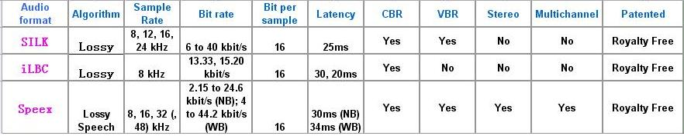
SILK ILBC Speex compare

Slide 18
Opus Characteristics:
Sampling rate: 8 – 48 kHz (narrowband-fullband)
Bitrates: 6 – 510 kb/s
Frame sizes: 2.5 – 60 ms
Mono and stereo support
Speech and music support
Flexible rate control
Variable complexity

Slide 19
Agenda
Audio basic knowledge sharing
Audio codecs
Room processing
RPD/RPM audio
Introduce our internal audio debug tool

Slide 20
Room Processing
Acoustic echo cancellation(AEC)
Automatic gain control(AGC)
Noise suppression
Noise Block
Keyboard Noise suppression
Headset Acoustic Bubble
Acoustic Beam/Fence
Music mode

Slide 21
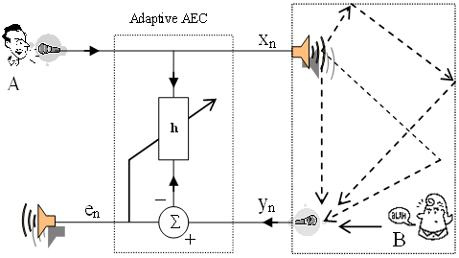
AEC

Slide 22
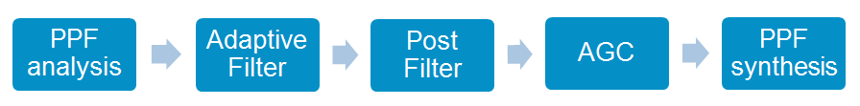
Polycom AEC
- Polyphase Filter Bank analysis
- Adaptive Filter for AEC
- Background noise estimation, activity detection and AEC control
- PostFiltering on the selected mic only
- AGC on the selected mic only
- Polyphase Filter Bank synthesis

Slide 23
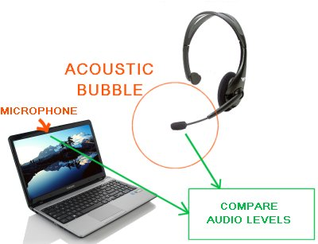
Headset Acoustic Bubble
Virtual Bubble Surrounds Microphone
Sound outside bubble not picked up
Sound inside bubble is picked up
Works by comparing audio of headset
microphone with microphone of laptop.
Major modifications to Real Presence Desktop Windows audio drivers to allow low latency access to both microphones.

Slide 24
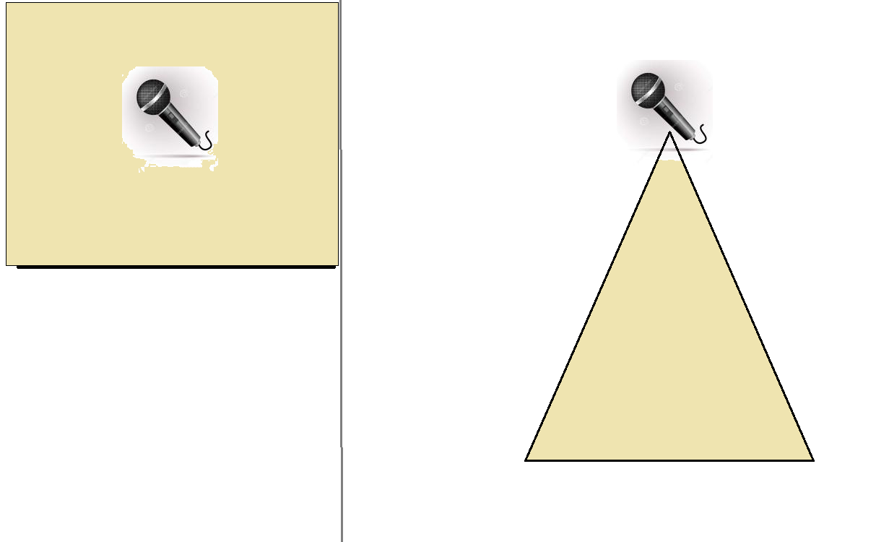
Acoustic Fence/Beam

Slide 25
Agenda
Audio basic knowledge sharing
Audio codecs
Room processing
RPD/RPM audio
Introduce our internal audio debug tool

Slide 26
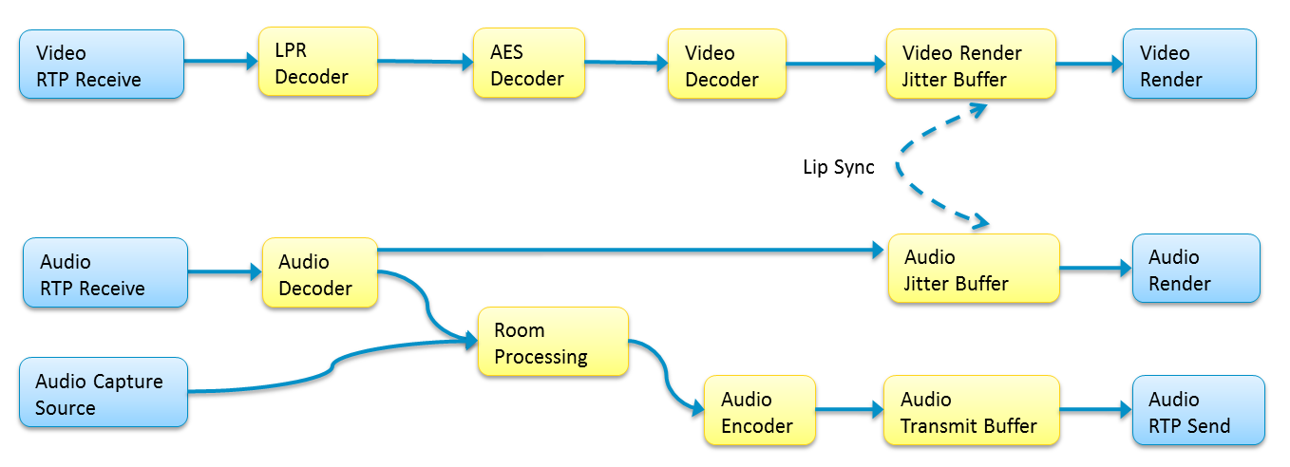
Audio Pipeline

Slide 27
RPD/RPM audio
DTMF
Microphone volume control
Howling suppression
Flow control
Lip sync(AV sync)

Slide 28
Agenda
Audio basic knowledge sharing
Audio codecs
Room processing
RPD/RPM audio
Introduce our internal audio debug tool

Slide 29
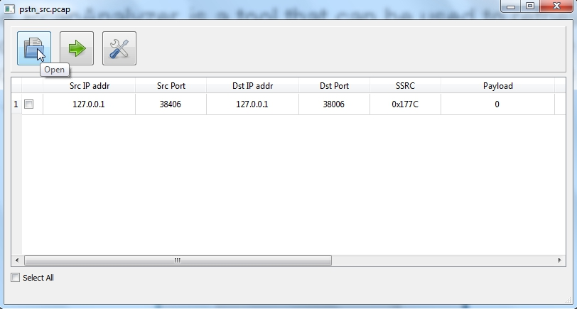
Introduce our internal audio debug tool(Developed by Ji Ben)
The PcapAnalyzer is a tool that can be used to retrieve audio data from pcap file and decode them. Then the uncompressed audio can be loaded into the software, such as Adobe Audition CS6 or Audacity, for analysis.

Slide 30
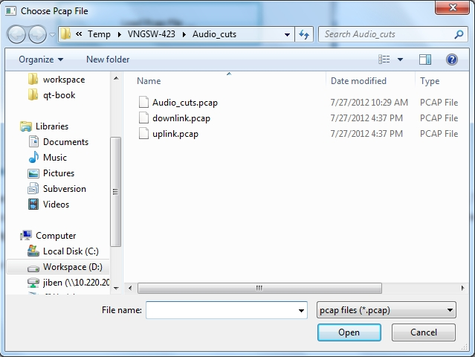
Introduce our internal audio debug tool
a. Click the “Open” button to select a pcap file

Slide 31
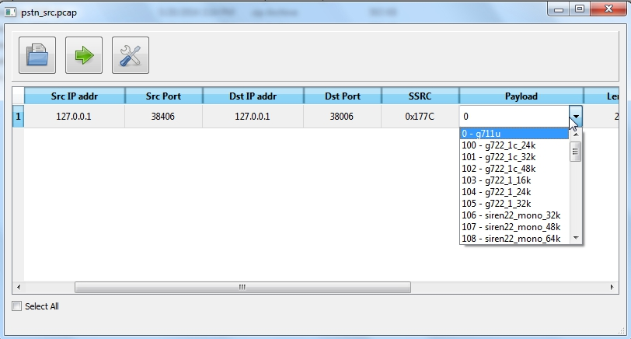
Introduce our internal audio debug tool
b. double-click one cell in the “Payload” column to choose the right payload type.

Slide 32
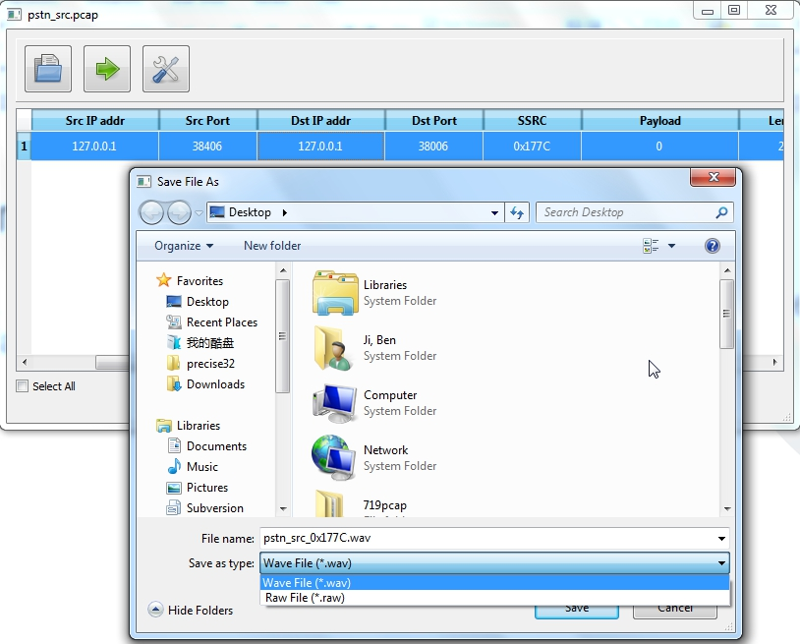
Introduce our internal audio debug tool
c. double-click somewhere in the stream to decode, then the “Save File as” dialog will be opened to help choose where to save the decoded stream.
d. once click the “Save”
button, the decoding
process will start
automatically

Slide 33
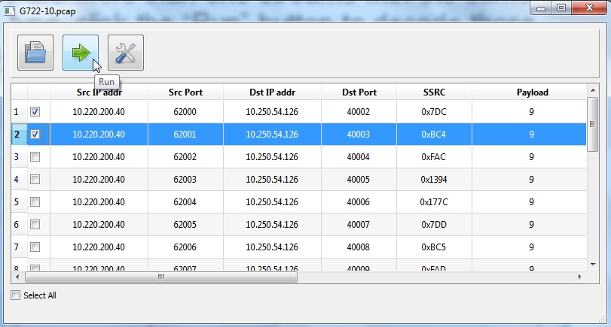
Introduce our internal audio debug tool
e. if there are more than one streams with the same payload type to decode at the same time, click the “Run” button to run in the batch mode.

Slide 34
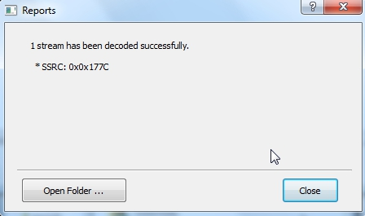
Introduce our internal audio debug tool
f. Once the process of decoding finishes, a message dialog will display

Slide 35
Thanks!

